Slide 1
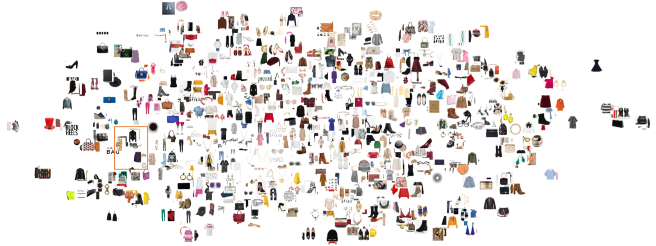
Fashion Compatibility based Recommender System
APCDS – Cohort 2
Team 13
08 May 2022
Notes:
Shalini

Slide 2







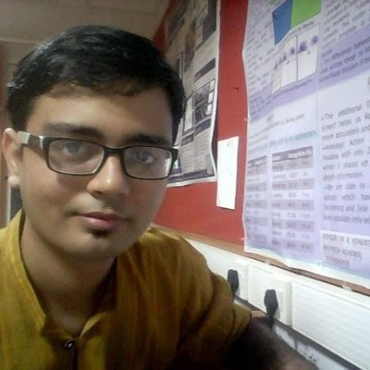
OUR TEAM
Mala
Arun
Avadhoot
Gopikrishna
Deepti
Shalini
Arvinder
Mentor: Jaley Dholakiya

Slide 3
Agenda
Fashion Industry Outlook
Why worry about Shopping experience?
Role of Recommender systems
Why compatibility based recommender?
Model thought
Bi-LSTM and visual semantic embedding based model
Implementation details
Validation thought
Limitations and Future directions

Slide 4
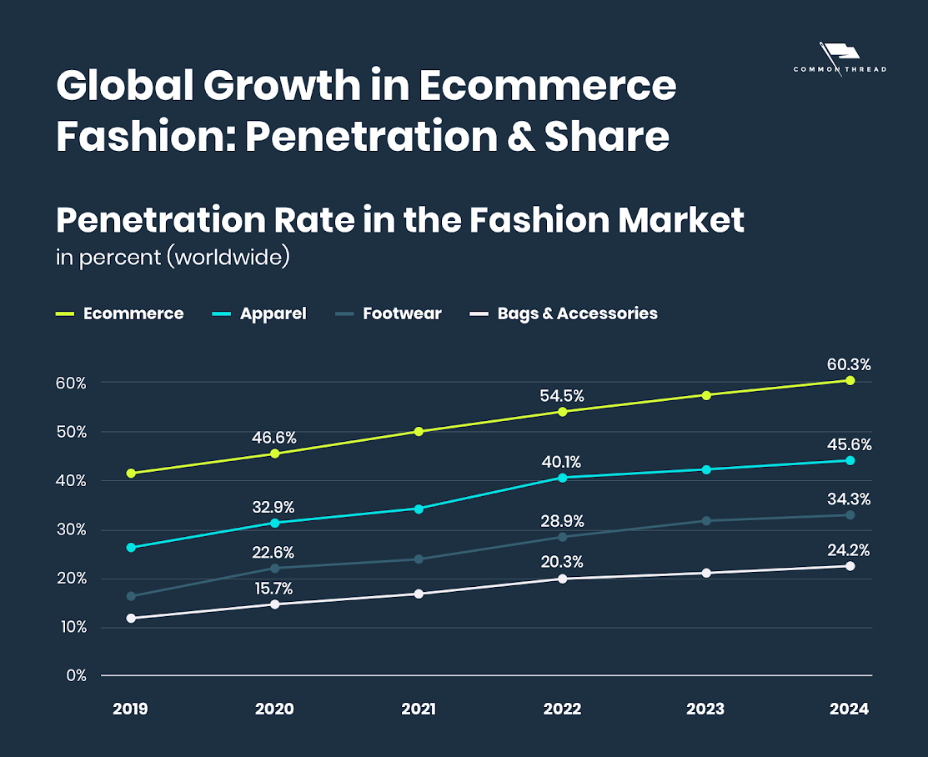
Fashion Industry Outlook
Industry size: $3T worldwide and 2% of GDP worldwide
eCommerce Fashion: $728B in 2021
Expected size: $1T by 2024
Over 60% penetration by 2024
Fastest growing segments: Apparel (growth rate: 17.4%), followed by Footwear, and Accessories
Challenge for Ecommerce platforms is to improve revenue, contain losses
Improve customer experience
Improve Average Order Value - move beyond playing on lowest price proposition
Notes:
Shalini
References: https://www.datafeedwatch.com/blog/fashion-industry-analysis#:~:text=%20An%20industry%20analysis%20of%20Fashion%20eCommerce%20in,and%20omnichannel%20strategies%20are%20becoming%20increasingly...%20More%20

Slide 5
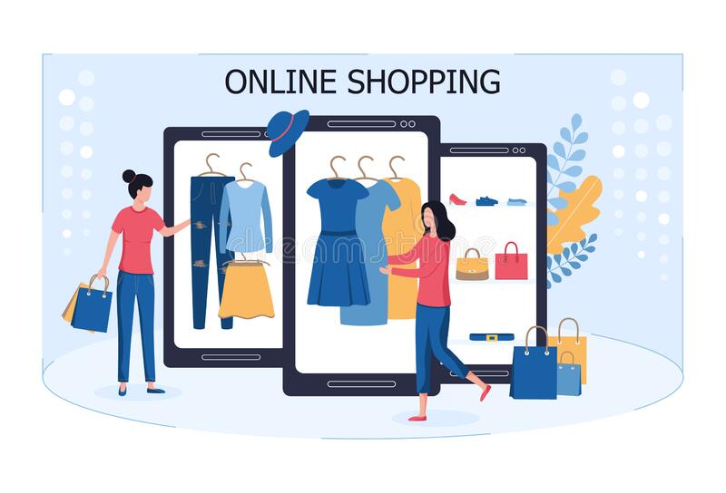

Online vs In-store Purchasing experience
Online Purchasing Experience
In-store Purchasing Experience
Pros:
Convenience of time and location: Shop from anywhere, anytime
Greater selection of items
Ease of delivery, as fast as same day
No crowds, No lines
Access to best price & discounts
Cons:
Can’t try things on: Fit and compatibility is an issue
Discrepancies in look and feel of the product
No consultative help for item recommendations
Must wait for deliveries
Additional shipping costs
Impulse purchases
Pros:
Trying before buying
WUSIWUG
Interacting with staff at stores
Having what I bought immediately
Cons:
Limited selection of items
Not convenient, need to dedicate considerable time
Higher prices
Limited payment options
Notes:
Shalini
what challenges and benefits in e-commerce experience versus in-store experience?
any pain points by consumers in fashion outfit selections?
https://squareup.com/us/en/townsquare/in-person-shopping-experience

Slide 6
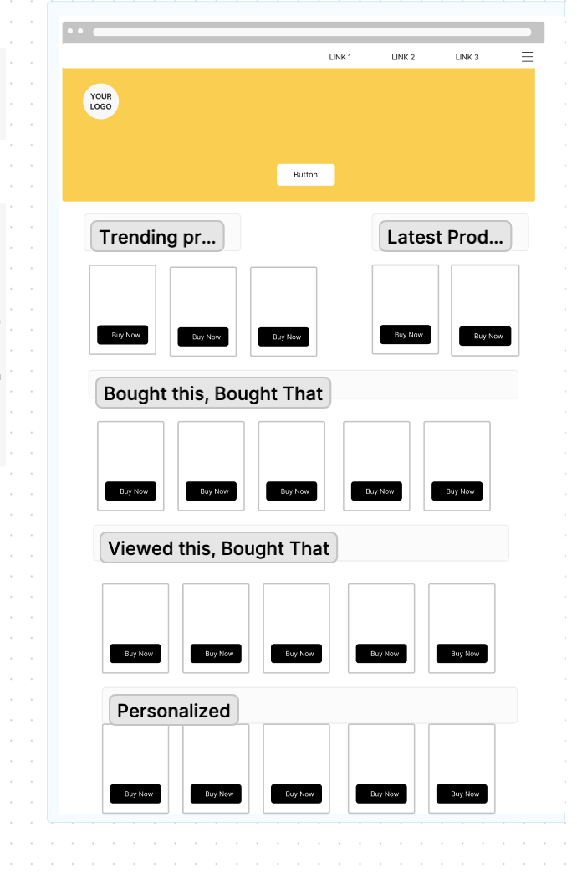
Recommendation systems proxy for social process
eCommerce systems deploy recommendation systems to suggest items based on
Content based systems: based on items viewed/ bought
Similar items: Similarity between the source items and the catalogue
Complimentary items: Dissimilar than source, but typically bought together (companion items) like phone and case
Collaborative filtering systems: suggests items preferred by ‘similar’ people
Bought this, bought that: based on final purchase
Viewed this, bought that: based on viewing patterns
Popularity based systems: Principle of popularity and anything trending, Check items which are most popular (by sale, views etc)
Personalized: Dynamically based on customers overall purchase history
Tests have measured a lift of upto 12.5% increase in conversion with content based recommendations and upto 35% increase in conversion with collaborative filtering based recommendations.

Slide 7
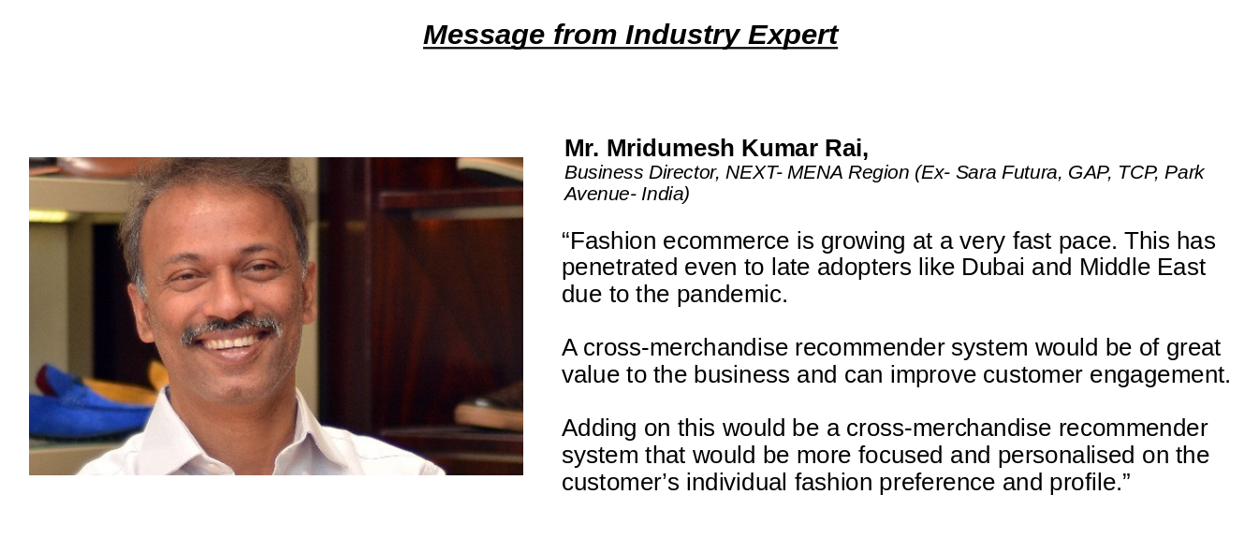
Providing meaningful recommendations is hard
Items: “Fast Fashion”
Short lifetime of items: a couple of months on average
Large retailers release new garments daily
Seasons complicate pairing
Fast moving trends
Users
‘Taste’ varies a lot
Cultural/ physique differences
What this means for recommenders
Item catalogue changes rapidly
High sparsity
Use content data
We need recommenders that can recognize changes in user preference and respond quickly
Notes:
Mala

Slide 8
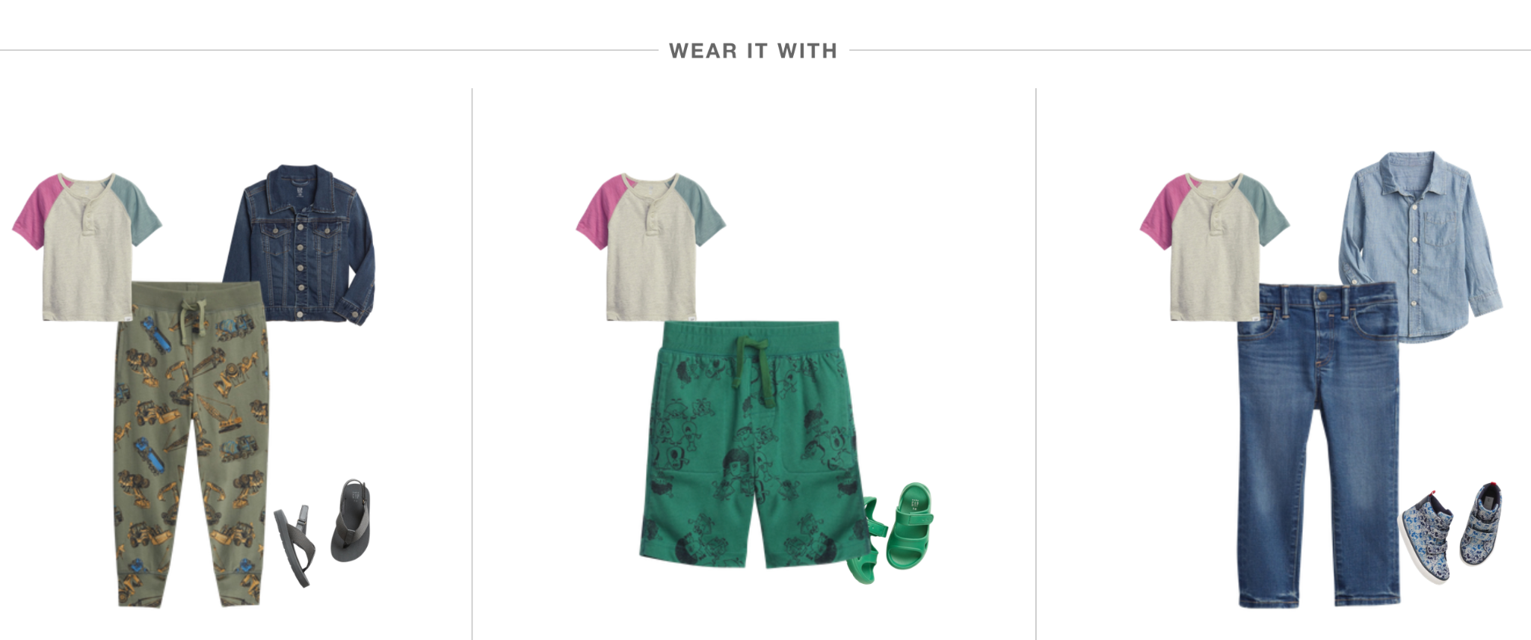
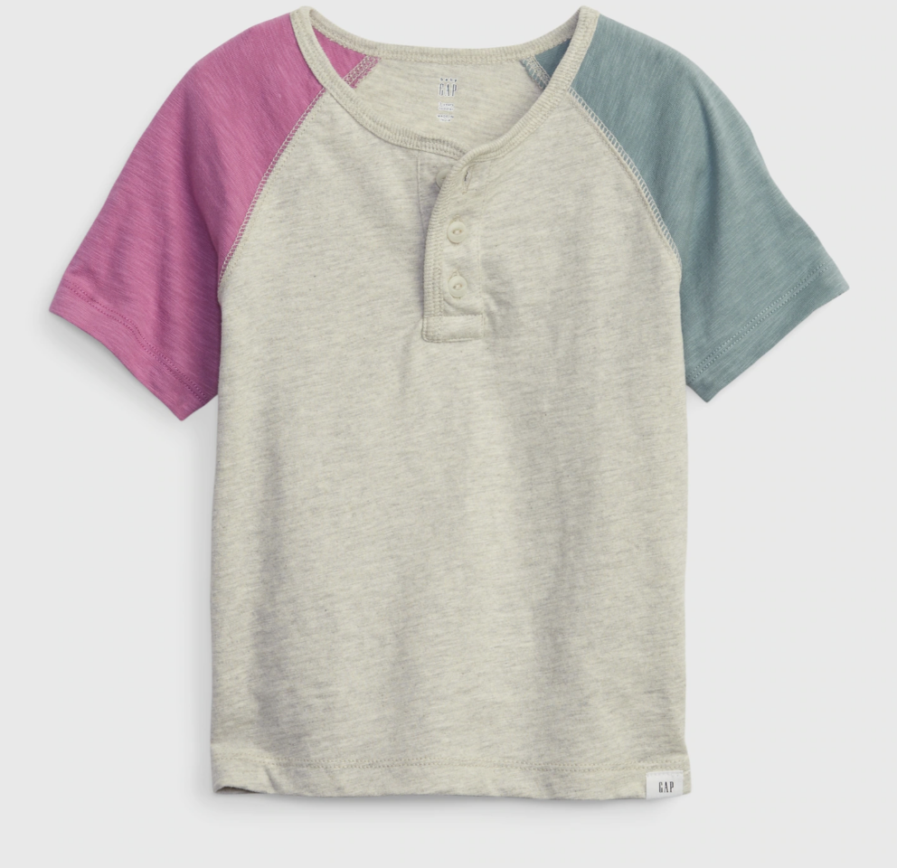
The Eternal Dilemma
My choice
What do I wear it with?
Making a complete outfit is one of the key challenges of online purchases
Notes:
Mala

Slide 9

Fashion Compatibility Recommender
Our Goal
Recommend items which are compatible to item being viewed
Input is the image customer is viewing (or placed in the cart) recommended images would be placed in widget
Items should be visibly compatible and share similar style;
These items should form a complete ensemble without redundancy.
Generalize compatibility for more than 2 items
Benefits
Increase number of items in order, increasing Average order value
Increase customer satisfaction of finding the complete ensemble
Notes:
Avadhoot - what are objectives of Compatibility recommender? No point in referring another pants to consumer when he’s placed a pants in a cart - we should have category complementarity. Further compatibility is about color and style (casuals versus formal versus party). We should be able to generalize it for more than 2 items.

Slide 10
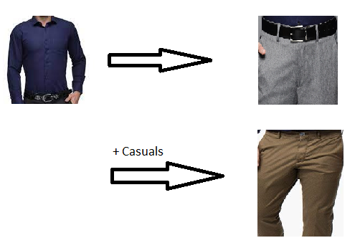
Model Thought - Ways to consider compatibility
Rule based recommenders
Create rules like recommend black/grey pants for a white shirt
Item Sequence
Given item(s), predict next category
Given item(s), predict next category and a specific item
Sequence is suggestive of modelling with LSTM/ GRU
Bi-Directional LSTM?
Formal Shirt → Formal Pants → Formal Shoes → ?
Notes:
Avadhoot

Slide 11
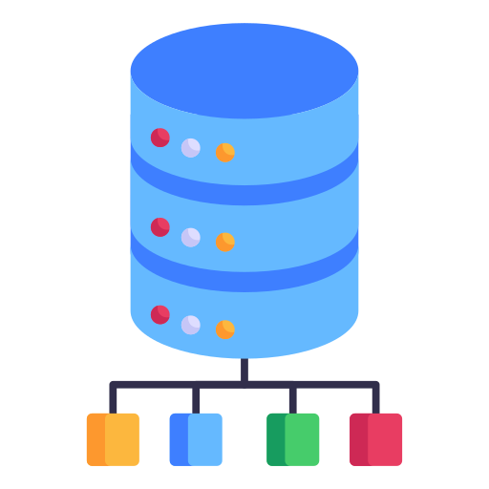

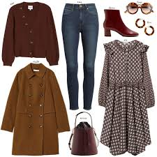



Data Set
13 GB of Image data comprising of 33375 outfits and 4,44,371 images
Images are crowdsourced
Images within an outfit are named sequentially as 1.jpg, 2.jpg, …
Filtered to 21,889 usable outfit dataset. Dataset split as
Training dataset - 17316 outfits with 2,19,195 images
Validation dataset - 1497 outfits with 20,173 images
Test dataset - 3076 outfits with 41762 images
Vocabulary file with 2756 word dictionary

Slide 12
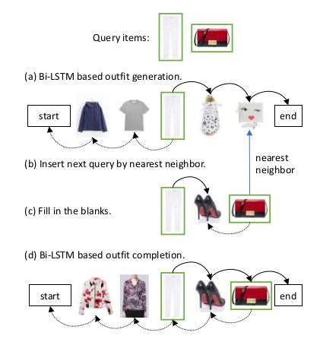
Model components and implementation
Feature Extraction using cNN
Representing image with embeddings
Text representation using
One-Hot encoding
BERT embeddings
Fashion Compatibility Learning using bi-LSTM
Training in Forward Direction
Training in Backward Direction
Visual-Semantic Embedding
Similarity based matching
Joint Modeling - visual + semantic description of item
Notes:
Avadhoot

Slide 13
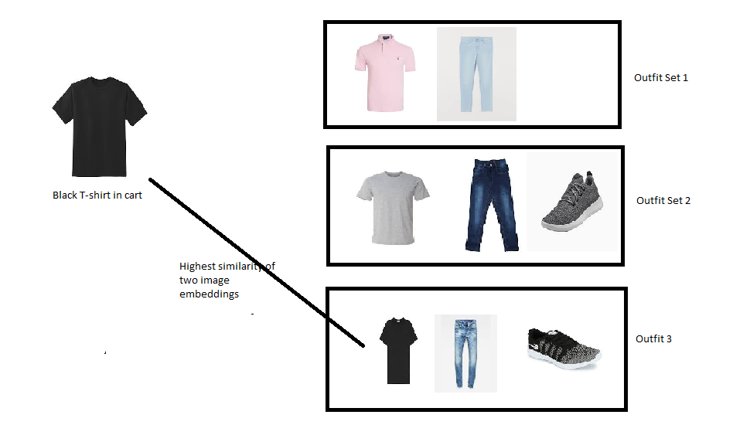
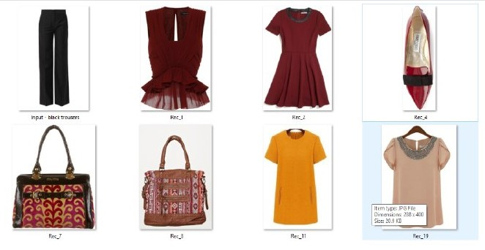
Baseline: RESNET50 Embeddings based hack!
Matching embeddings and selecting complements
Pink top, and a bag and shoes to go with black pants!
Notes:
Avadhoot

Slide 14
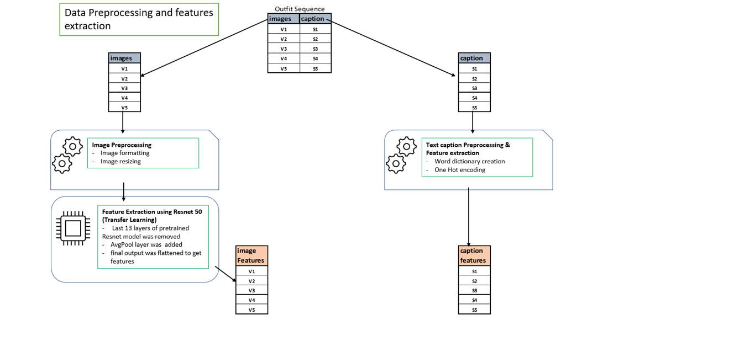
Data preprocessing & Creating features
Notes:
Gopi
→ consider an outfit seq consist of images and corresponding captions
→ as can been seen in diagram, we are pre-processing image seq which involves formatting and resizing to make it fit for resnet model
→ Then we are passing images through Resnet50 model to get image features
→ pretrained Resnet model consist of all the layers except last 13 layers, on top of it we have added avgPool layer
→ and finally flatten the output to get final image features
→ In case of caption we have create word dictionary consisting of tokes from all the captions
→ using this dictionary we are converting caption into one hot encoding features

Slide 15
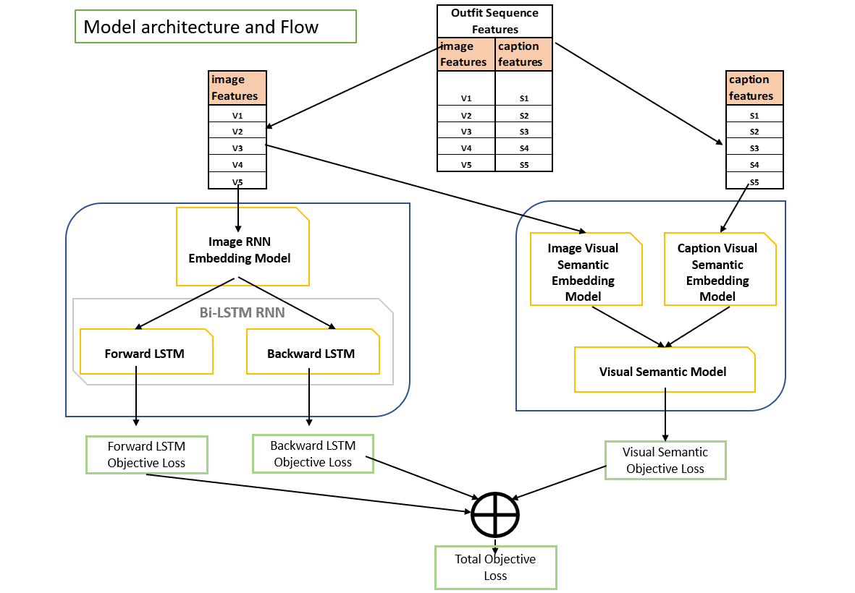
Model Architecture and Flow
Notes:
Gopi
→ once we will receive outfit sequence features for both image and caption from preprocessing steps
→ we will pass image sequence through image rnn embedding layer (which is trainable layer)
→ further this embedding will be passed through forward LSTM and Backward LSTM.
→ from both LSTM’s we will get 2 objective losses
→ Further this seq of image and caption features will be passed through image VS embedding and caption VS embedding tto bring both image and corresponding captions into same joint embedding space.
→ visual semantic objective function will be calculated such that distance between image and corresponding caption embedding should be least but their distance from other images and captions should be more
→ finally all the 3 objectives 2 from bi-lstm and 1 from visual semantic will be added to get final objective loss

Slide 16
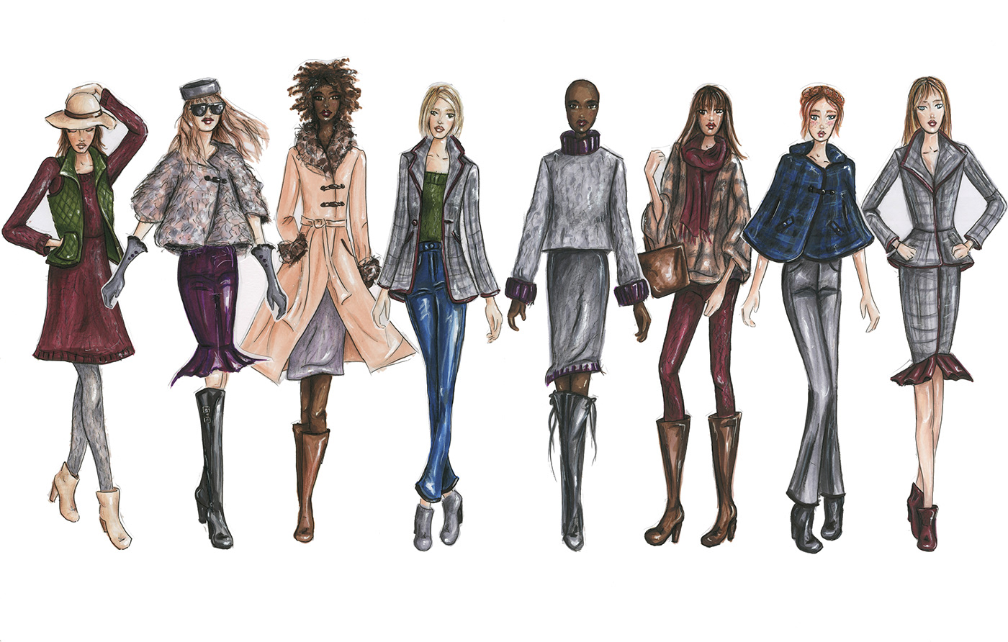
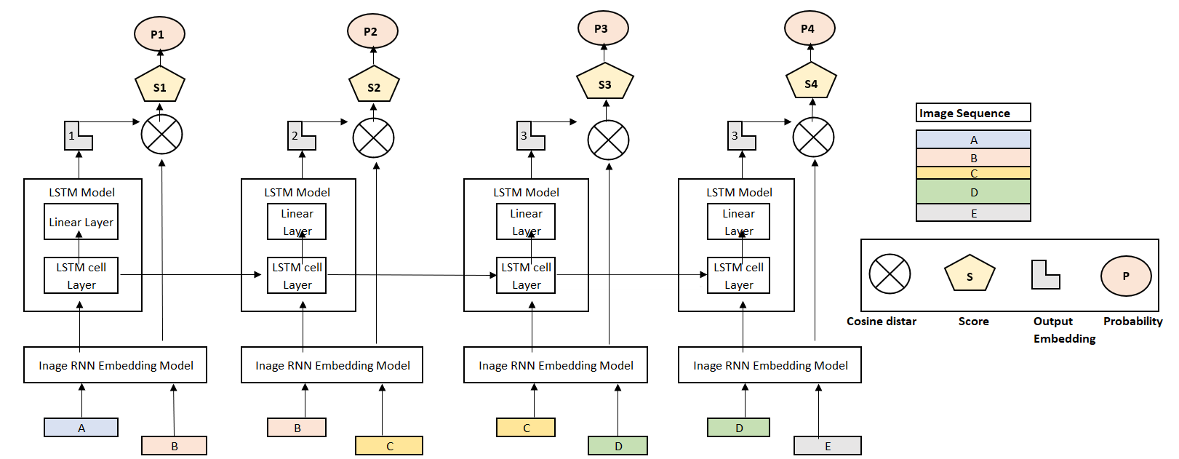
bi-LSTM Model Details
Notes:
Arvinder
Bi lstm
Hello everyone
Now i will walk u through the detailed understanding of bi lstm model
At the right hand side you can see image feature seq ABCDE derived from resnet50 model as a part of outfit.
At the left hand side u can see the unrolled version of lstm model across timesteps
Now Lets consider the first lstm time step.
Here u can see image feature A and the next image feature B are pass through image rnn embedding
Further image feature A is passed through lstm layers to generate L1 output embedding.
After that we are calculating the cosine distance S1 between L1 embedding and image embedding B
and then finally we are calculating probability P1 by using sparse softmax cross entropy.
In similarly fashion, we will compute probability for subsequent time steps
And finally add then up to get final loss
This is how lstm model training is getting performed.
Kindly note -
This approach is applicable to both forward and backward lstm.
In case of backward we will simply flip the sequence ABCDE to EDCBA
Also note
Fashion items in outfit seq are already ordered from top to bottom and then assoceries in training set

Slide 17
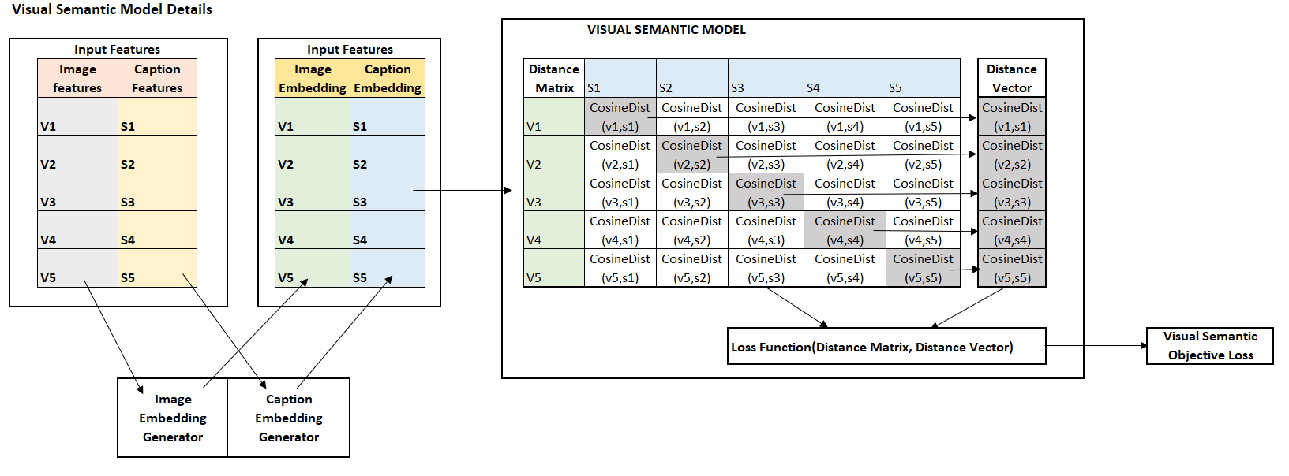
Details of Visual Semantic Model
Notes:
Arvinder
Now I will explain you nitty grities of visual semantic model
Here at extreme left hand side you can see outfit sequence containing images and corresponding caption feature
First of all we are passing image feature through image visual semantic embedding and similarly we are passing caption features through caption visual semantic embedding.
The objective here is to transform both images and captions to join embedding space.
Where in we finally aim to reduce cosine distance between images and corresponding captions.
Now in visual semantic block we are calculating distance matrix which is actually represent distance of all images embedding with all visual embeddings.
From this matrix we have extracted a diagonal vector which represent distance of images and corresponding caption
Now our objective is that entries in matrix except diagonal should be higher value but entries in diagonal vector should have lower values
For that purpose we have defined a loss function

Slide 18




Tech Stack Used
Notes:
Gopi
Google JAX
JAX is a numerical computing library that combines NumPy, automatic differentiation, and first-class GPU/TPU support.
Under the hood it exploit pure functional programming paradigm for parallel processing
Can differentiate almost any kindly of function
Deepmind Haiku
àHaiku is a simple neural network library for JAX that enables users to use familiar object-oriented programming models while allowing full access to JAX's pure function transformations.
Haiku provide common modules such as Linear, Convolution, RNN etc
Advantages over other libraries
Unlike TensorFlow, JAX is much more natural and python like. You don’t have to define placeholders, scopes as we do in TensorFlow. Need not learn TF syntax. Most of the Numpy and python syntax work with JAX.
Python 3
JAX
JAX is a numerical computing library that combines NumPy, automatic differentiation, and first-class GPU/TPU support.
JAX is Autograd and XLA, brought together for high-performance machine learning research.
Haiku
Haiku is a simple neural network library for JAX developed, similar to a neural network library for TensorFlow.
A library built on top of JAX designed to provide simple, composable abstractions for machine learning research.
A simple neural network library for JAX that enables users to use familiar object-oriented programming models while allowing full access to JAX’s pure function transformations. Haiku is designed to make the common things we do such as managing model parameters and other model state simpler and similar in spirit to the Sonnet library that has been widely used across DeepMind.
Streamlit
Streamlit is an open-source Python library that makes it easy to create and share beautiful, custom web apps for machine learning and data science. In just a few minutes you can build and deploy powerful data apps.

Slide 19
DEMO
Notes:
.Deepthi

Slide 20
Metrics/ Model Evaluation
Training & Validation loss useful for tuning model hyperparameters
Starting values - Training loss- 24.89, Valid. loss - 25.77
Values at end of 50 epochs - training loss- 0.008, Valid. loss - 0.104
When the recommender is live, one can use
Clickthrough rate and conversion rate
Improvement in AOV
No simple Mean Absolute Percentage Error (MAPE) or Confusion matrix like measures available
Visual Compatibility is what we could do!
Notes:
Arun

Slide 21
Limitations
The first severe limitations in producing high performance algorithms in the fashion domain is the lack of availability of a properly structured, publicly available dataset that could be used as a proxy for performances in a a real use case scenario.
Sparsity of the datasets in the fashion domain is way larger than sparsity in other domains.
The set of features that have been used in order to feed the model and learn style compatibility are, for the moment, taken directly from previous works in the domain, but there is no formal or empirical guarantee that those are the most relevant features to be considered.
Notes:
Arun

Slide 22
Future Directions
Things we could not do, or could improve solution
A lot remains be done for research about Recommender Systems in the Fashion domain, both in the process of addressing the limitations highlighted in previous section and trying to advance performances in tasks that are better correlated with actual use case scenarios
Investigation of the features importance and impact on the process of outfit composition, the explanation of what clothing features are more correlated in a fashionable outfit, the exploration of different type of visual inputs, such as full-body images, through techniques of visual object segmentation
From a more recommender-related side, it would be relevant to join the information about outfit compatibility and completion and those related to users profiles and histories in typical e-commerce setting, and try to create models able to recommend items using the probability of completing an outfit given the his user’s past purchases
Extract implicit negative ratings through the analysis of returned item.
How to integrate community with recommendations
Recommender systems will be used in the future to predict demand for products, enabling earlier communication back the supply chain.
Notes:
Arun

Slide 23
Thanks

Slide 24
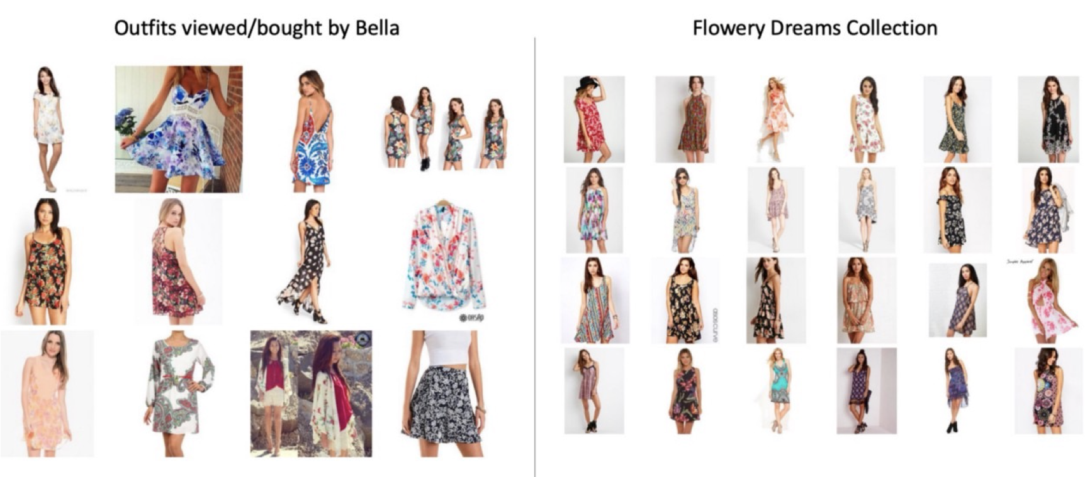
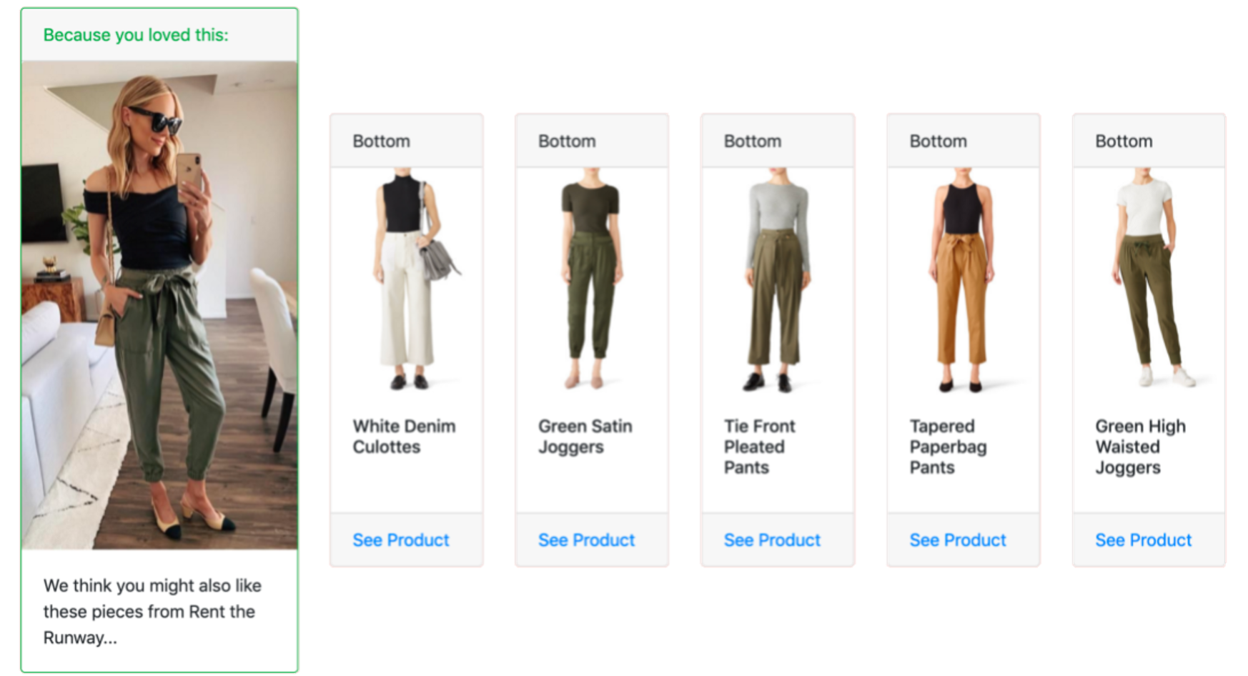
Recommendation systems proxy for social process
eCommerce systems deploy recommendation systems to suggest items based on
Content based systems: based on items viewed/ bought
Similar items: Similarity between the source items and the catalogue
Complimentary items: Dissimilar than source, but typically bought together (companion items) like phone and case
Collaborative filtering systems: suggests items preferred by ‘similar’ people
Bought this, bought that: based on final purchase
Viewed this, bought that: based on viewing patterns
Popularity based systems: Principle of popularity and anything trending, Check items which are most popular (by sale, views etc)
Personalized: Dynamically based on customers overall purchase history
Tests have measured a lift of upto 12.5% increase in conversion with content based recommendations and upto 35% increase in conversion with collaborative filtering based recommendations.

